Slide 1
Lecture 8: Advanced SQL

Slide 2
TRIGGERS

Slide 3
Inventory management
Assume that we need to make sure that current product sales can be supported with sufficient product availability
Automatically write a product order to the vendor once a product drops to its minimum allowable quantity:
Update product quantity on hand each time there is a sale on this product
Reorder the product when it drops to its minimum
Write SQL statements to update the product quantity
Run this statement whenever a sale of this product takes place

Slide 4
Triggers
A trigger is a statement that is executed automatically by the system as a side effect of a modification to the database:
Triggers can be used for:
Automating business procedures
Automatically maintaining data integrity and consistency
To design a trigger mechanism, we must:
Specify the conditions under which the trigger is to be executed.
Specify the actions to be taken when the trigger executes.

Slide 5
Syntax for creating Triggers
CREATE TRIGGER trigger_name
[BEFORE/AFTER] [DELETE /INSERT/UPDATE OF column_name]
ON table_name
[FOR EACH ROW]
variable_names data_types := initial_values
BEGIN
SQL instructions
END;
Dropping a trigger:
DROP TRIGGER trigger_name

Slide 6
Notes on Triggers (1)
[BEFORE/AFTER]
Means before or after the changes are stored in the database
Triggers are associated with a table ➔ ON table_name
When you drop a table, all triggers on that table are dropped
When you drop a trigger, the corresponding table is not dropped

Slide 7
Notes on Triggers (2)
There cannot be multiple triggers for a given table that have the same trigger event and trigger time. For example, you cannot have two BEFORE UPDATE triggers for a table
(Note: As of MySQL 5.7.2 it is allowed using precedes/follows)
Within the trigger body, the OLD and NEW keywords enable you to access columns in the rows affected by a trigger. OLD and NEW are MySQL extensions to triggers; they are not case sensitive.
In an INSERT trigger, only NEW.col_name can be used; there is no old row.
In a DELETE trigger, only OLD.col_name can be used; there is no new row.
In an UPDATE trigger, you can use OLD.col_name to refer to the columns of a row before it is updated and NEW.col_name to refer to the columns of the row after it is updated.

Slide 8
Setting up variables
https://dev.mysql.com/doc/refman/5.7/en/set-variable.html
Syntax
SET @var_name = expr [, @var_name = expr] ...
Examples:
set @name = 43;
SET @t1=1, @t2=2, @t3:=4;
set @total_salary = (SELECT SUM(salary) FROM instructor);

Slide 9
Trigger Example 1
set @num_invoices=0;
create trigger test_trigger
after insert on invoice
for each row
set @num_invoices = @num_invoices+1;
Show triggers;
Testing the Trigger:
insert into invoice values (10037,10011,’2019-02-25');
select @num_invoices;

Slide 10
Begin….End
Question:
What if there are a set of SQL statements that you want to
run?
create trigger test_trigger
after insert on invoice
for each row
set @num_invoices = @num_invoices+1;
Do Something else 1;
Do something else 2;
. . . .

Slide 11
Begin…End and delimiter
MySQL expects semi-colon after each statement
BEGIN….END: defines execution of multiple statements
For procedural code, such as triggers, function, procedures, need to tell MySQL to treat multiple statements as one set
Delimiter is a key word for this purpose
Delimiter can consist of a single character or multiple characters
Most commonly used delimiter //
Avoid use of backlash(\) character because that is the escape character for MySQL

Slide 12
Trigger Example 2
delimiter //
create trigger upd_check
before update on line
for each row
begin
if new.line_units < 0 then
set new.line_units = 0;
elseif new.line_units > 100 then
set new.line_units = 100;
end if;
end;
// delimiter ;

Slide 13
Why do we need triggers?
Enforce constraints that cannot be enforced at the database design and implementation levels
Add functionality, automate critical actions and facilitate the enforcement of referential integrity
Update table values, insert records, and call other stored procedures
Automatic generation of derived column values (e.g. DOB/Age)
Enforcing business or security constraints
Creation of replica tables for backup purposes “High Availability”

Slide 14
Trigger Example 3
Create a trigger to automatically reduce the quantity on hand of a product with every sale
Sales are reported in the LINE table
Quantity on hand is stored in the PRODUCT table
delimiter //
CREATE TRIGGER TRG_LINE_PROD
AFTER INSERT ON line
FOR EACH ROW
BEGIN
UPDATE product
SET prod_quant = prod_quant - new.line_units
WHERE product.prod_code = new.prod_code;
END;
// delimiter ;

Slide 15
Trigger : Using variables
CREATE TRIGGER trigger_name
[BEFORE/AFTER] [DELETE /INSERT/UPDATE OF column_name]
ON table_name
[FOR EACH ROW]
DECLARE variable_names data_types := initial_values
BEGIN
SQL instructions
END;

Slide 16
Trigger Example 4: Using variables
Update the customer balance (cus_balance) in the customer table after inserting new row in table line.
You can also display a specific trigger using:
SHOW CREATE TRIGGER trg_cus_balance;

Slide 17
Example 4 Solution
//Step 1: Add a new column to Customer table
alter table customer
add cus_balance int;
//Step 2: Add initial values for customer balance
create view CusBalanceView as
select cus_code, sum(line_units*prod_price) as balance
from invoice I, line L, product P
where I.inv_number = l.inv_number and l.prod_code = p.prod_code
group by cus_code;
update customer C
set cus_balance = (select balance
from CusBalanceView V
where v.cus_code = c.cus_code);

Slide 18
delimiter //
create trigger trg_cus_balance
after insert on line
for each row
Begin
declare w_cus int;
declare w_tot int;
declare p_price int;
select prod_price into p_price
from product p
where p.prod_code = new.prod_code;
select cus_code into w_cus
from invoice
where inv_number = new.inv_number;
set @w_tot = new.line_units * p_price;
update customer
set cus_balance = cus_balance + @w_tot
where cus_code = w_cus;
end;
//delimiter ;

Slide 19
Handling Errors during Triggers
If a BEFORE trigger fails, the operation on the corresponding row is not performed.
A BEFORE trigger is activated by the attempt to insert or modify the row, regardless of whether the attempt subsequently succeeds.
An AFTER trigger is executed only if any BEFORE triggers and the row operation execute successfully.
An error during either a BEFORE or AFTER trigger results in failure of the entire statement that caused trigger invocation.

Slide 20
When Not To Use Triggers
Triggers were used earlier for tasks such as
Maintaining summary data (e.g., total salary of each department)
Replicating databases by recording changes to special relations (called change or delta relations) and having a separate process that applies the changes over to a replica
There are better ways of doing these now:
Databases today provide built in materialized view facilities to maintain summary data
Databases provide built-in support for replication
Encapsulation facilities can be used instead of triggers in many cases
Define methods to update fields
Carry out actions as part of the update methods instead of through a trigger

Slide 21
When Not To Use Triggers (Cont.)
Risk of unintended execution of triggers, for example, when
Loading data from a backup copy
Replicating updates at a remote site
Trigger execution can be disabled before such actions.
Other risks with triggers:
Error leading to failure of critical transactions that set off the trigger
Cascading execution

Slide 22
Triggers in MySQL
For more information and syntax, please refer to:
http://dev.mysql.com/doc/refman/5.0/en/trigger-syntax.html

Slide 23
Class Exercise 1
Write a trigger, each time a row is Inserted in the table Invoice_line, Insert a row in Invoice table. Assume that cus_code is 1001 and inv_date is today’s date
Invoice(inv_number int, cus_code varchar(5), inv_date date)
Invoice_Line(inv_number int, prod_code varchar(5), line_units int)

Slide 24
Class Exercise 2
Write an AFTER Insert trigger for the following Employee table. Check Date of Birth and calculate age. Update AGE field with calculated value in Employee_Info table
Employee (Emp_ID int, DOB date)
Employee_Info (Emp_ID int, Fname char, Lname char, Age int)
Set variable Current_Date to CURDATE()
Substract DOB from Current_Date to find Age
Hint: Consider using variables to calculate and store Age

Slide 25
Procedures

Slide 26
Stored Procedures
A named collection of procedural and SQL statements
Stored in the database
Used to encapsulate and represent business transactions:
Execute a group of SQL statements as a single transaction
Addition of a new customer
A product sale
Advantages:
Reduce network traffic and enhance performance
Reduce code duplication by means of code sharing
Parameter passing

Slide 27
Syntax for creating Procedures
CREATE PROCEDURE sp_name ([proc_parameter[,...]])
[characteristic ...] routine_body
proc_parameter:
[ IN | OUT | INOUT ] param_name type
routine_body:
Valid SQL routine statement
Characteristic
COMMENT ‘string’
Dropping a procedure:
DROP PROCEDURE procedure_name

Slide 28
Example 1
Create a procedure to assign an additional 5% discount on all products
delimiter //
create procedure prc_prod_disc()
begin
update product
set prod_price = prod_price*0.95;
end //
delimiter ;
Call prc_prod_disc();

Slide 29
Example 2
Create a procedure to assign an additional x% discount on all products.
delimiter //
create procedure prc_prod_disc_amt(in amount int)
begin
update product
set prod_price = (prod_price) – (prod_price*amount)/100;
end //
delimiter ;
Calling the procedure:
call PRC_PROD_DISC_AMT(10);

Slide 30
Class Exercise 3
Consider Department table from University database. Create a procedure to Insert a new row, but increase the budget amount by x%. Percentage amount should be input parameter for the procedure. Assume your own values for dept_name, building, budget.
department
(dept_name varchar(20),
building varchar(15),
budget numeric(12,2),
primary key (dept_name)
);
Write Call statement

Slide 31
Example 3
Write a procedure to add a new customer
CREATE PROCEDURE PRC_CUS_ADD
(IN W_CODE INT,
IN W_LN VARCHAR(10),
IN W_FN VARCHAR(10),
IN W_INIT VARCHAR(1),
IN W_AC INT,
IN W_PH INT)
BEGIN
INSERT INTO CUSTOMER
(CUS_CODE, CUS_LNAME, CUS_FNAME, CUS_INITIAL, CUS_AREACODE,CUS_PHONE)
VALUES (W_CODE, W_LN,W_FN,W_INIT,W_AC,W_PH);
END;

Slide 32
Example 4
Write a procedure to insert a line in LINE table. Check on the available quantity in Product table first.
CREATE PROCEDURE PRC_LINE_ADD
(IN W_INV INT, IN W_P_CODE INT, IN W_LU INT)
Begin
declare W_Q INT;
Set @W_Q = 0;
SELECT prod_quant INTO W_Q
FROM PRODUCT
WHERE PROD_CODE = W_P_CODE;
IF (W_LU <= W_Q) THEN
INSERT INTO LINE VALUES (W_INV,W_P_CODE,W_LU);
END IF;
END

Slide 33
Class Exercise 4
Consider Department and Instructor tables from University database. Create a procedure to Insert a line in Instructor table. Check if dept_name is Physics, increase salary by 20%. Input parameters are ID, Name, dept_name, salary
Department (dept_name varchar(20), building varchar(15), budget numeric(12,2))
Instructor (ID varchar(5), name varchar(20), dept_name varchar(20), salary numeric(8,2)

Slide 34
Example 5
Find all customers with a specific area code
delimiter // CREATE PROCEDURE GetCustomerByAreaCode(IN areaCode int) BEGIN SELECT cus_lname, cus_fname FROM customer WHERE cus_areacode = areacode; END // delimiter ;
call GetCustomerByAreaCode(615);

Slide 35
Error Messages
delimiter //
CREATE PROCEDURE PRC_LINE_ADD
(IN W_INV INT, IN W_P_CODE INT, IN W_LU INT)
Begin
declare W_Q INT;
SELECT prod_quant INTO W_Q
FROM PRODUCT
WHERE Prod_CODE = W_P_CODE;
IF (W_LU <= W_Q) THEN
INSERT INTO LINE VALUES (W_INV,W_P_CODE,W_LU);
ELSE signal SQlSTATE value ‘45000'
SET message_text = ‘ NOT ENOUGH QUANTITY';
END IF;
END //
delimiter ;

Slide 36
Revision of SQL

Slide 37
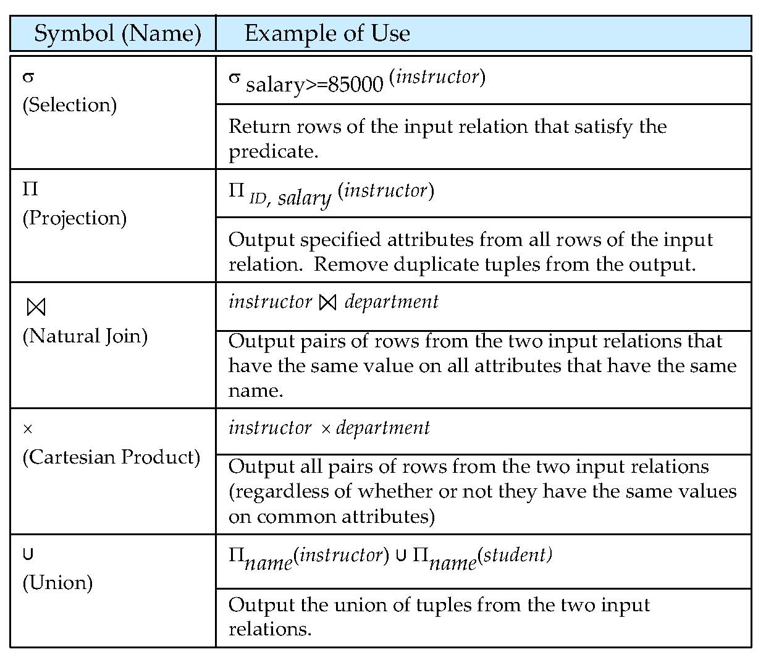
Relational Query Language
Notes:
37

Slide 38
DDL: Creating a table
create table tablename (
column 1 data type [constraint],
column 2 data type [constraint],
primary key (column x),
foreign key (column y) references tablename (column z),
constraint constraint)

Slide 39
create table department ( dept_name varchar(20), building varchar(20), budget numeric(12,2), primary key (dept_name) );
create table instructor (
ID varchar(5),
name varchar(20),
dept_name varchar(20),
salary numeric(8,2),
primary key (ID),
foreign key (dept_name) references department(dept_name));

Slide 40
CONSTRAINTS
Syntax :
CREATE TABLE [table name]
([column name] [data type]([size]) [column constraint]….
[table constraint] ([[column name]……])……);
create table instructor (id varchar(5),
name varchar(20) NOT NULL,
dept_name varchar(20) DEFAULT ‘Biology’,
salary numeric(8,2) CHECK (salary > 29000),
primary key (ID),
foreign key (dept_name) references department (dept_name)
);
Note: Review DDL script for more examples

Slide 41
Changing Table Structure
alter table
add: add a column or add a constraint
modify: change a column characteristic
drop: delete a column or drop a constraint
41

Slide 42
DML: INSERT
insert into tablename values (value_1,value_2,….,value_n)
A value is required for each attribute in the table
If a value is not known ➔ write NULL
insert into instructor values (10211,’Smith’,’Biology’,66000)
(10211,’Smith’,NULL,66000)
insert into tablename (column_1, column_2,…,column_n) values (value_1,value_2,….,value_n)
Inserting only a subset of the attributes
insert into instructor (ID,name) values (12121,’Wu’)
42

Slide 43
DML: update
update tablename
set columnname = expression
[where conditionlist]
update instructor
set salary = salary * 1.1
where dept_name = ’History’
CAUTION: If you don’t specify the where condition:
Then all rows in the table will be updated
43

Slide 44
DML: delete
delete from tablename
[where conditionlist]
delete from instrcutor
where name = ‘Wu’
Deletes only one row
delete from instructor
where salary < 10000
Deletes several rows
CAUTION: If you don’t specify the where condition:
Then all rows in the table will be deleted
44

Slide 45
DML: select
select columnlist
from tablename
[where condition];
Listing table rows
select name, dept_name
from student;
select ID, name
from instructor;
select name
from instructor
where dept_name = ‘history’
45

Slide 46
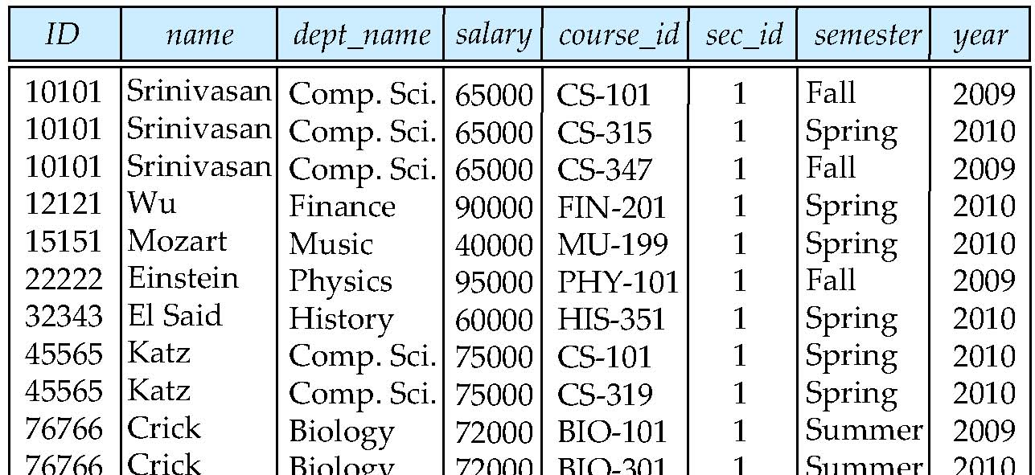
Natural Join
Natural join matches tuples with the same values for all common attributes, and retains only one copy of each common column
select * from instructor natural join teaches;

Slide 47
Set Operations
Find courses that ran in Fall 2009 OR in Spring 2010
select course_id from section where semester = ‘Fall’ and year = 2009 union select course_id from section where semester = ‘Spring’ and year = 2010
Find courses that ran in Fall 2009 AND in Spring 2010
select course_id from section where semester = ‘Fall’ and year = 2009 intersect select course_id from section where semester = ‘Spring’ and year = 2010
Find courses that ran in Fall 2009 BUT NOT in Spring 2010
select course_id from section where semester = ‘Fall’ and year = 2009 except select course_id from section where semester = ‘Spring’ and year = 2010
Notes:
47

Slide 48
Aggregate Functions
These functions operate on the multiset of values of a column of a relation, and return a value
avg: average value min: minimum value max: maximum value sum: sum of values count: number of values
Notes:
48

Slide 49
Aggregate Operators
SELECT COUNT (*)
FROM Sailors S
SELECT AVG (S.age)
FROM Sailors S
WHERE S.rating=10
COUNT (*)
COUNT ( [DISTINCT] A)
SUM ( [DISTINCT] A)
AVG ( [DISTINCT] A)
MAX (A)
MIN (A)
SELECT AVG ( DISTINCT S.age)
FROM Sailors S
WHERE S.rating=10
SELECT COUNT (DISTINCT S.rating)
FROM Sailors S
WHERE S.sname=‘Bob’
SELECT MAX (S.age)
FROM Sailors S

Slide 50
Queries With group by and having
SELECT [DISTINCT] target-list
FROM relation-list
WHERE qualification
GROUP BY grouping-list
HAVING group-qualification
The target-list contains (i) attribute names (ii) terms with aggregate operations (e.g., MIN (S.age)).
The attribute list must be a subset of grouping-list. Intuitively, each answer tuple corresponds to a group, and these attributes must have a single value per group. (A group is a set of tuples that have the same value for all attributes in grouping-list.)

Slide 51
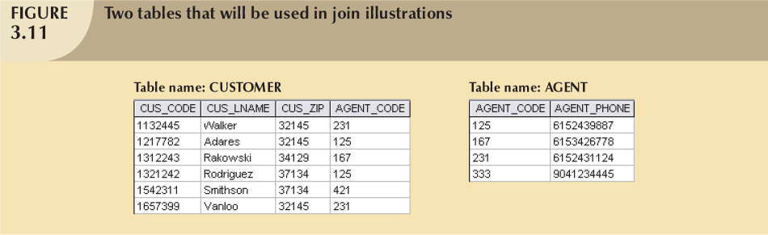
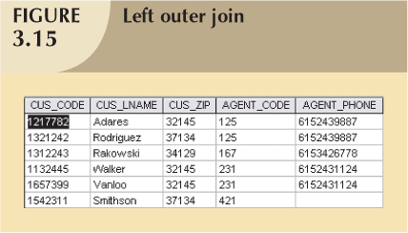
Left Outer Join
null
null
null

Slide 52
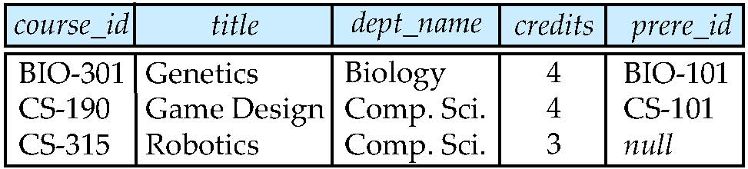
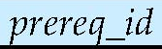
Left Outer Join
course natural left outer join prereq
select *
from course C left outer join prereq P on (C.course_id = P.course_id)

Slide 53
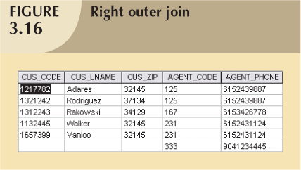
Right Outer Join
null
null
null

Slide 54
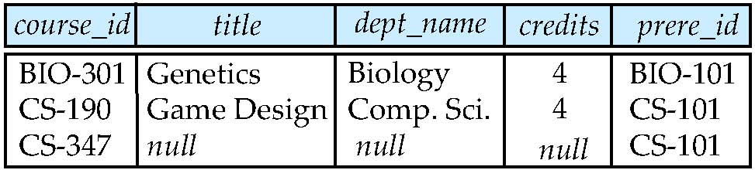
Right Outer Join
course natural right outer join prereq
select *
from prereq P left outer join course C on (C.course_id = P.course_id)

Slide 55
View Definition
A view is defined using the create view statement which has the form
create view view_name as < query expression >
where <query expression> is any legal SQL expression. The view name is represented by v.
Once a view is defined, the view name can be used to refer to the virtual relation that the view generates.
View definition is not the same as creating a new relation by evaluating the query expression
Rather, a view definition causes the saving of an expression; the expression is substituted into queries using the view.

Slide 56
Cascading Actions in Referential Integrity
create table course ( course_id char(5) primary key, title varchar(20), foreign key dept_name varchar(20) references department)
create table course ( … dept_name varchar(20), foreign key (dept_name) references department on delete cascade on update cascade, . . . )

Slide 57
Syntax for creating Triggers
CREATE TRIGGER trigger_name
[BEFORE/AFTER] [DELETE /INSERT/UPDATE OF column_name]
ON table_name
[FOR EACH ROW]
variable_names data_types := initial_values
BEGIN
SQL instructions
END;
Dropping a trigger:
DROP TRIGGER trigger_name

Slide 58
Setting up variables
https://dev.mysql.com/doc/refman/5.7/en/set-variable.html
Syntax
SET @var_name = expr [, @var_name = expr] ...
Examples:
set @name = 43;
set @total_tax = (SELECT SUM(tax) FROM taxable_transactions);
SET @t1=1, @t2=2, @t3:=4;

Slide 59
Syntax for creating Procedures
CREATE PROCEDURE sp_name ([proc_parameter[,...]])
[characteristic ...] routine_body
proc_parameter:
[ IN | OUT | INOUT ] param_name type
routine_body:
Valid SQL routine statement
Dropping a procedure:
DROP PROCEDURE procedure_name

Slide 60
Error Messages
delimiter //
CREATE PROCEDURE PRC_LINE_ADD
(IN W_INV INT, IN W_P_CODE INT, IN W_LU INT)
Begin
declare W_Q INT;
SELECT prod_quant INTO W_Q
FROM PRODUCT
WHERE Prod_CODE = W_P_CODE;
IF (W_LU <= W_Q) THEN
INSERT INTO LINE VALUES (W_INV,W_P_CODE,W_LU);
ELSE signal SQlSTATE value ‘45000'
SET message_text = ‘ NOT ENOUGH QUANTITY';
END IF;
END //
delimiter ;

Slide 61
Reading and Assignment
No. | Date | Topics and Required Reading | Assignments
 |  |  |  | start of class day

